Slide 1
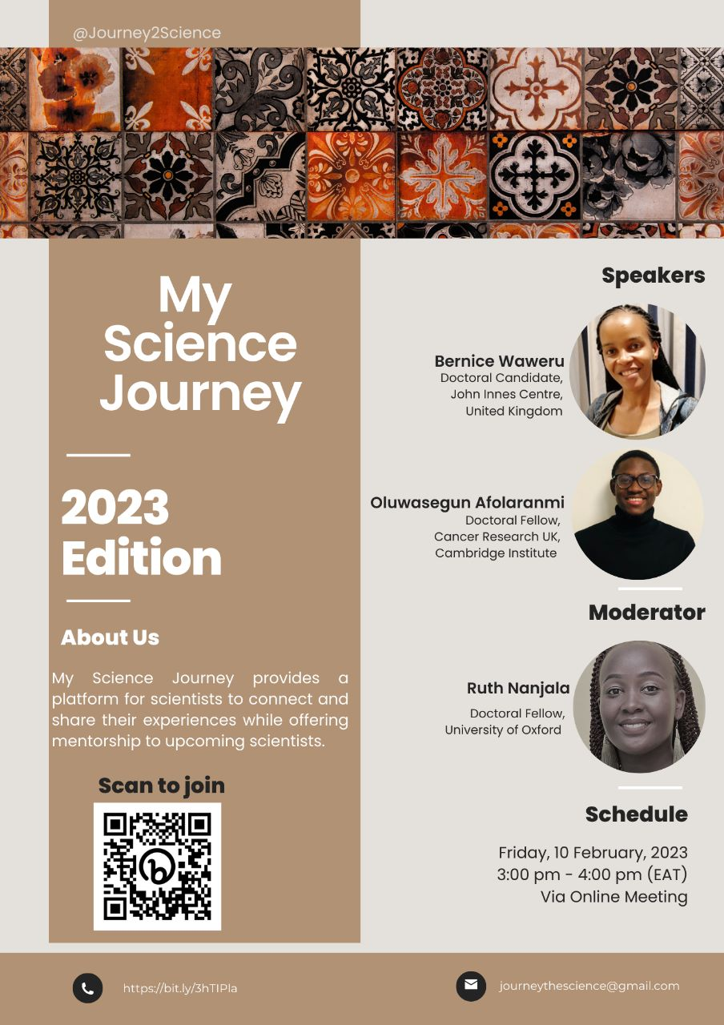
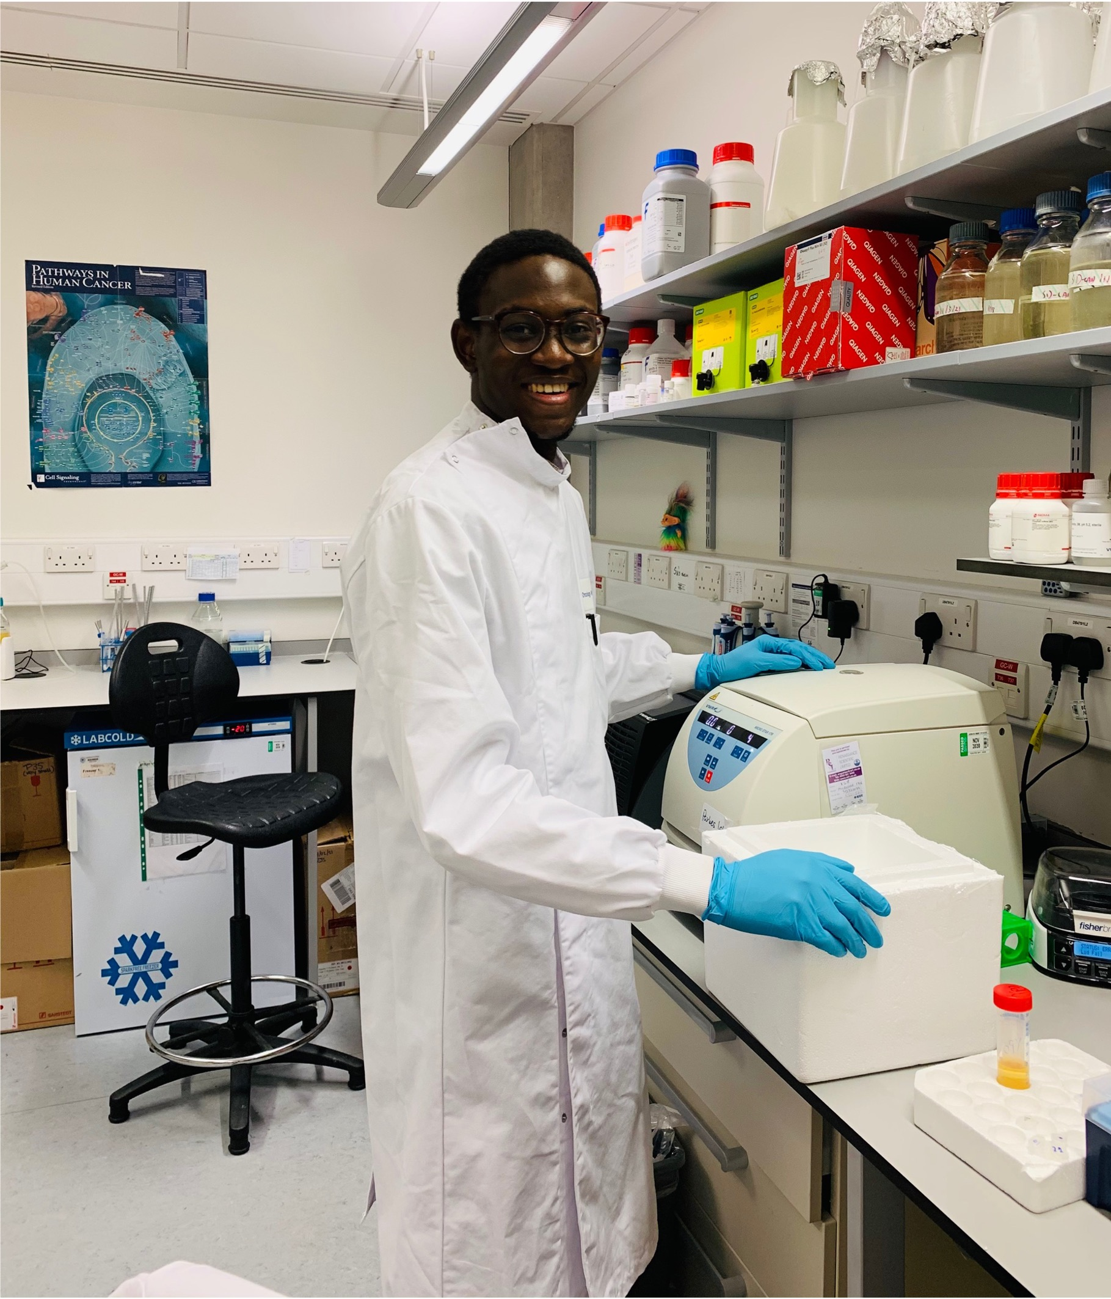

Slide 2
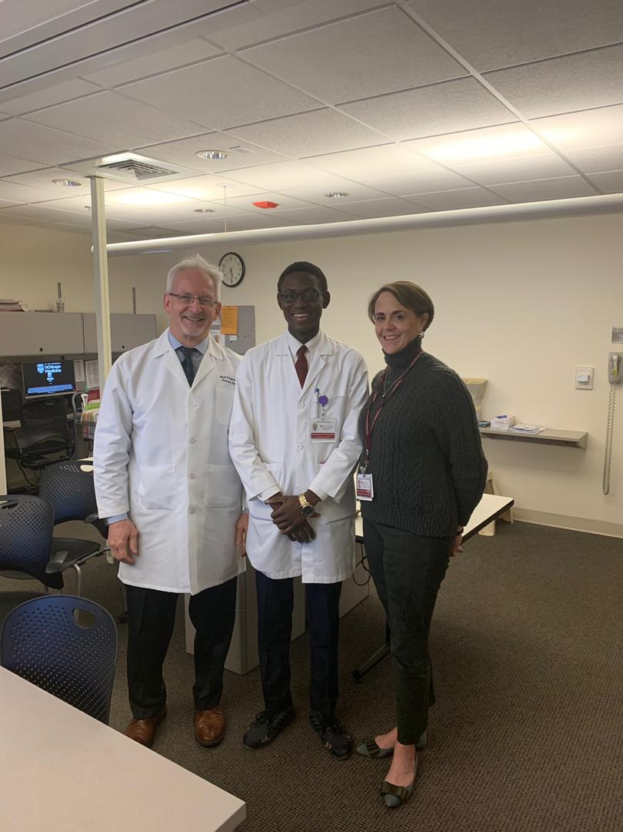
Medical school: 2012-2019
University of Chicago Medicine
Dec 2018
Academic excellence
Competency
Growth
Research
Soft skills

Slide 3

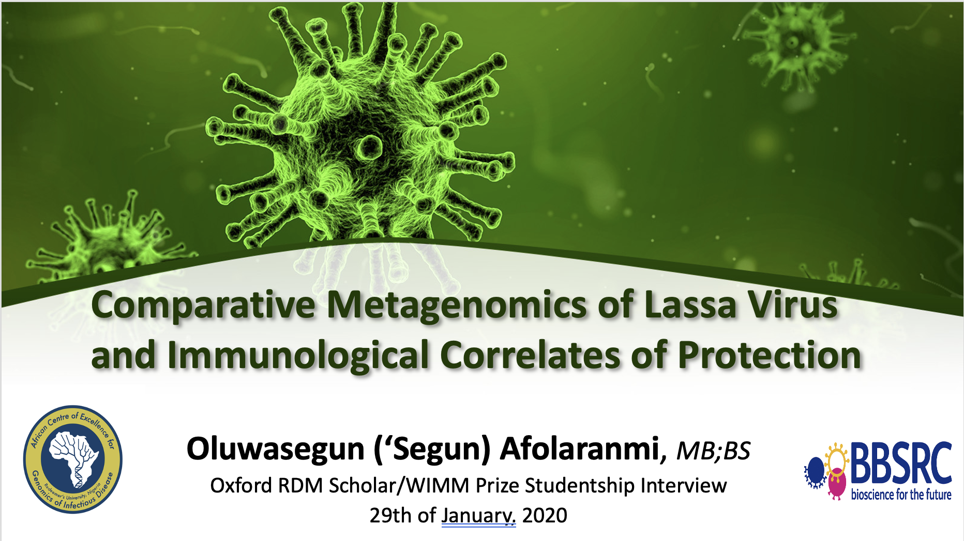
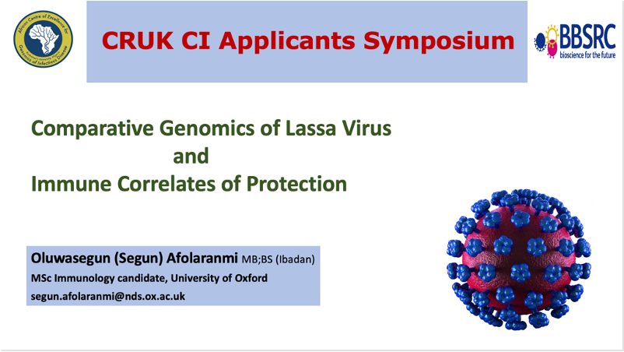
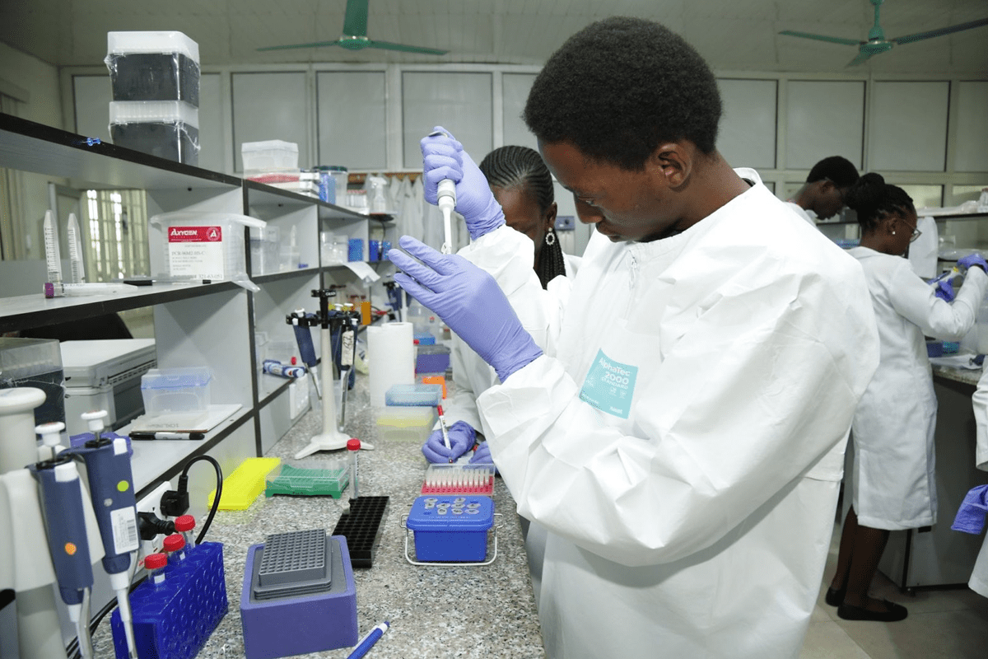
ACEGID: OCT– Nov 2019

Slide 4

Masters: 2020/2021
Integrated immunology
Thesis: Tumor Immunology
Foundational science background
Skills!!!: Wet lab
Basic bioinformatics
Great mentor/PI

Slide 5
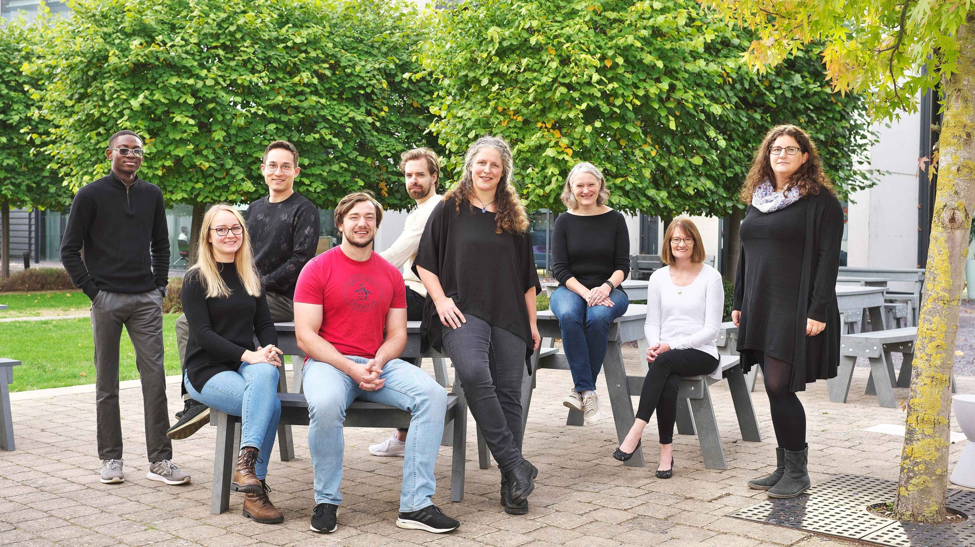
PhD- Cancer Immunology
Great PI/lab culture
Skills!!!
Thinking like a scientist
Discovery
Networking

Slide 6
WHAT CAN I be?
WHAT CAN I do?
Academia
“Industry”: …
Clinician-scientist
Wet-lab
Computational
“Translational”
Regulatory/Business…

Slide 7
How can I be?
Develop your knowledge and relevant skills for your field
Gather information about available career pathways and opportunities
Seek local and international internships/opportunities
Graduate studies: Where? With whom? What? How?
Ask questions and seek guidance
Keep an open mind and attitude

Slide 8

Thank you!!!

